Slide 1


CSGE601020 | Dasar-Dasar Pemrograman 1
Komputer dan Programming
Fariz Darari
A video lecture using this slideset is available (+ other cool Python lesson videos):
https://bit.ly/pymooc-id
Notes:
open.v01
https://pixabay.com/photos/dock-feet-footwear-jetty-mat-1846008/

Slide 2
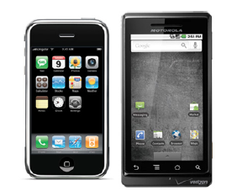
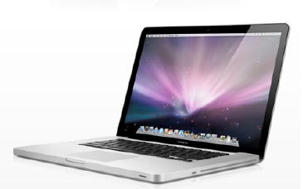
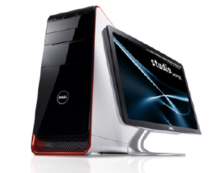
Apa itu komputer?
Komputer adalah mesin yang dapat:
Menyimpan data dalam bentuk angka, teks, gambar, & video
Berinteraksi dengan perangkat seperti layar monitor, speaker, dan printer
Mengeksekusi program, misalnya program ramalan asmara cuaca, game, web browser, serta Integrated Development Environment (IDE)
Notes:
IDE = program utk membuat program

Slide 3
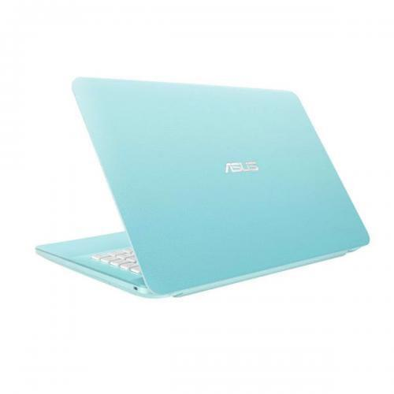
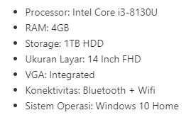
Spesifikasi komputer – Contoh dunia nyata
ASUS VivoBook X441UA
Notes:
CPU = Brain, dealing with calculations, measured in frequency aka clock speed (cycles per second) = up to 3.4 billion cycles per second,
typically contains multiple cores (= 2 cores)
RAM = RAM gives temporary room to think for computers, when 3000 browser tabs are opened, RAM is the first to suffer
Storage = Harddrive is room to store stuff permanently, HDD (mechanical, magnetic discs) vs SSD (flash memory)
Screen = FHD is for full high definition (1920x1080 pixels aka 1080p)
VGA/GPU = Integrated but actually Intel UHD Graphics 620,
GPU does calculations like CPU but only related to rendering pictures, animations, or videos.
GPUs are much better at performing many ops in parallel.
https://www.avast.com/c-ssd-vs-hdd
https://ark.intel.com/content/www/us/en/ark/products/137977/intel-core-i3-8130u-processor-4m-cache-up-to-3-40-ghz.html
https://gizmodo.com/what-all-of-your-computers-specs-really-mean-1794869384
https://www.bhinneka.com/asus-vivobook-x441ua-ga334t-peacock-blue-sku3332030608

Slide 4
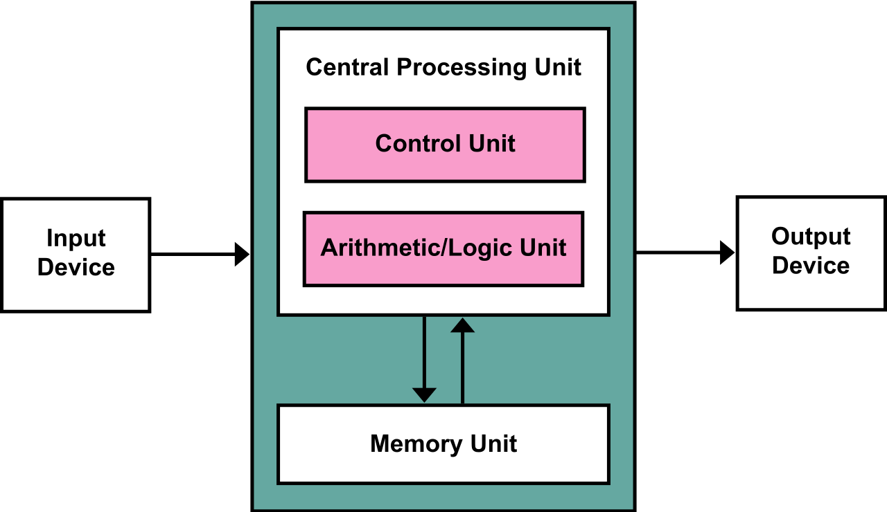
Arsitektur komputer (von Neumann, 1945)
Notes:
Von Neumann architecture (First Draft of a Report on EDVAC, 1945): http://web.mit.edu/STS.035/www/PDFs/edvac.pdf
Input device: keyboard, mouse, mic, webcam
Output device: screen, printer, speaker
CPU: processing data (doing computation)
Control unit: The control unit of the CPU contains circuitry that uses electrical signals to direct the entire computer system to carry out, or execute, stored program instructions. Like an orchestra leader, the control unit does not execute program instructions; rather, it directs other parts of the system to do so. The control unit must communicate with both the arithmetic/logic unit and memory.
ALU: The arithmetic/logic unit (ALU) contains the electronic circuitry that executes all arithmetic and logical operations.
Memory unit: RAM and hard drive
https://en.wikipedia.org/wiki/Von_Neumann_architecture
https://homepage.cs.uri.edu/faculty/wolfe/book/Readings/Reading04.htm

Slide 5
Apa itu ilmu komputer?
Computer Science is the study of computers and computational systems. Unlike electrical and computer engineers, computer scientists deal mostly with software and software systems; this includes their theory, design, development, and application.
Notes:
Ilmu komputer tidak harus tentang komputer, tapi segala sesuatu yang terkait dengan komputasi
https://undergrad.cs.umd.edu/what-computer-science
https://www.cs.cmu.edu/~choset/whatiscs.html

Slide 6
Ilmu komputer merupakan perpaduan
Mathematicians: Use formal languages to denote ideas (specifically
computations)
Engineers: Design things, assemble components into systems,
and evaluate tradeoffs among alternatives
Scientists: Observe the behavior of complex systems, form hypotheses, and test predictions
Notes:
Source: Think Python 2e – Allen Downey

Slide 7
Aspek-aspek ilmu komputer
Principal areas of study within Computer Science include:
Artificial intelligence
Computer systems and networks
Security
Data science
Human–computer interaction
Vision and graphics
Software engineering
And many others!
Notes:
HCI: The study of interaction between people (users) and hardware, software, websites, & mobile devices. It involves computer science, behavioral sciences, design and other fields of study.
https://undergrad.cs.umd.edu/what-computer-science

Slide 8
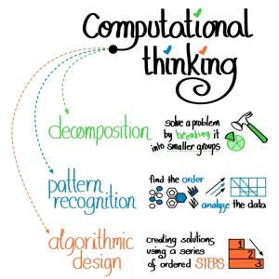
Apa itu computational thinking?
Notes:
https://education.ohio.gov/Media/Extra-Credit-Blog/November-2016/GUEST-BLOG-What-is-Computational-Thinking-and-Why

Slide 9
Apa itu program?
Suatu urutan instruksi yang dilakukan komputer dalam pemecahan masalah.
Program terbentuk dari kumpulan instruksi-instruksi sederhana pada komputer:
Taruh titik biru pada lokasi tertentu di layar monitor
Kirim huruf B ke printer
Dapatkan nilai dari suatu lokasi pada RAM
Tambahkan dua angka
Jika nilai X kurang dari 0, stop programnya
Ulangi suatu instruksi satu juta kali
Notes:
Computational thinking dituangkan dalam program.
kondisi
Iterasi/repetisi

Slide 10


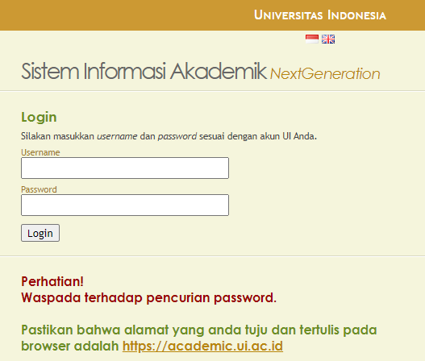



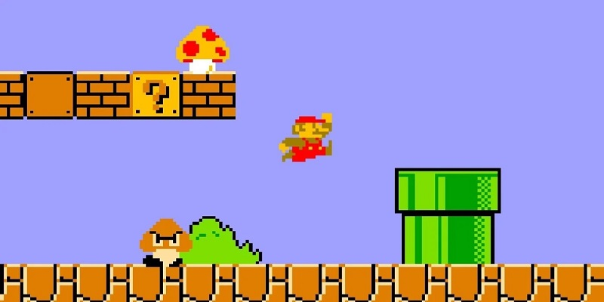

Contoh program
Notes:
https://www.iconfinder.com/icons/5296499/facebook_facebook_logo_fb_fcb_icon
https://www.iconfinder.com/icons/317753/browser_chrome_internet_web_web_browser_icon
https://techno.okezone.com/read/2020/07/13/16/2245787/game-legendaris-super-mario-bros-terjual-rp1-6-miliar
https://www.iconfinder.com/icons/3146791/logo_whatsapp_icon
https://www.iconfinder.com/icons/1298766/music_sound_spotify_icon
https://www.iconfinder.com/icons/4202113/dropbox_dropbox_logo_file_sharing_icon

Slide 11
Jumlah baris kode
Windows 3.1 (1992): 2.5 juta baris
Boeing 787: 6.5 juta baris
Google Chrome: 6.7 juta baris
Android: 12 juta baris
Microsoft Office 2013: 45 juta baris
Facebook (w/o backend code): 62 juta baris
Mac OS X 10.4: 86 juta baris
Google (all services):
Notes:
Google services: Google Search, Gmail, Google Maps, Google Docs, Youtube, etc
Credits:
https://www.businessinsider.com/how-many-lines-of-code-it-takes-to-run-different-software-2017-2?r=US&IR=T
https://docs.google.com/spreadsheets/d/1s9u0uprmuJvwR2fkRqxJ4W5Wfomimmk9pwGTK4Dn_UI/edit#gid=5

Slide 12
Jumlah baris kode
Windows 3.1 (1992): 2.5 juta baris
Boeing 787: 6.5 juta baris
Google Chrome: 6.7 juta baris
Android: 12 juta baris
Microsoft Office 2013: 45 juta baris
Facebook (w/o backend code): 62 juta baris
Mac OS X 10.4: 86 juta baris
Google (all services): 2000 juta baris
Notes:
Google services: Google Search, Gmail, Google Maps, Google Docs, Youtube, etc
Credits:
https://www.businessinsider.com/how-many-lines-of-code-it-takes-to-run-different-software-2017-2?r=US&IR=T
https://docs.google.com/spreadsheets/d/1s9u0uprmuJvwR2fkRqxJ4W5Wfomimmk9pwGTK4Dn_UI/edit#gid=5

Slide 13

Apa itu programming?
Computer programming is a way of giving computers instructions about what they should do next. These instructions are known as code, and computer programmers write code to solve problems or perform a task.
Notes:
Reading task: https://www.freecodecamp.org/news/what-is-computer-programming-defining-software-development/
https://news.codecademy.com/what-is-computer-programming/
https://www.iconfinder.com/icons/532707/api_coding_developer_development_man_programming_screen_icon

Slide 14

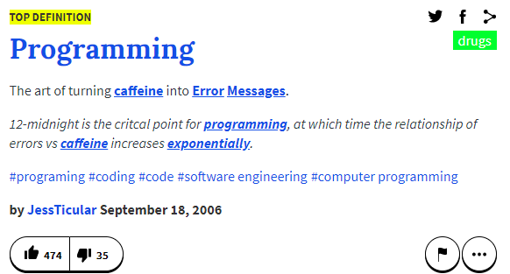
Apa itu programming?
Notes:
https://www.urbandictionary.com/define.php?term=Programming
https://unsplash.com/photos/8hQUCIoXf8o

Slide 15
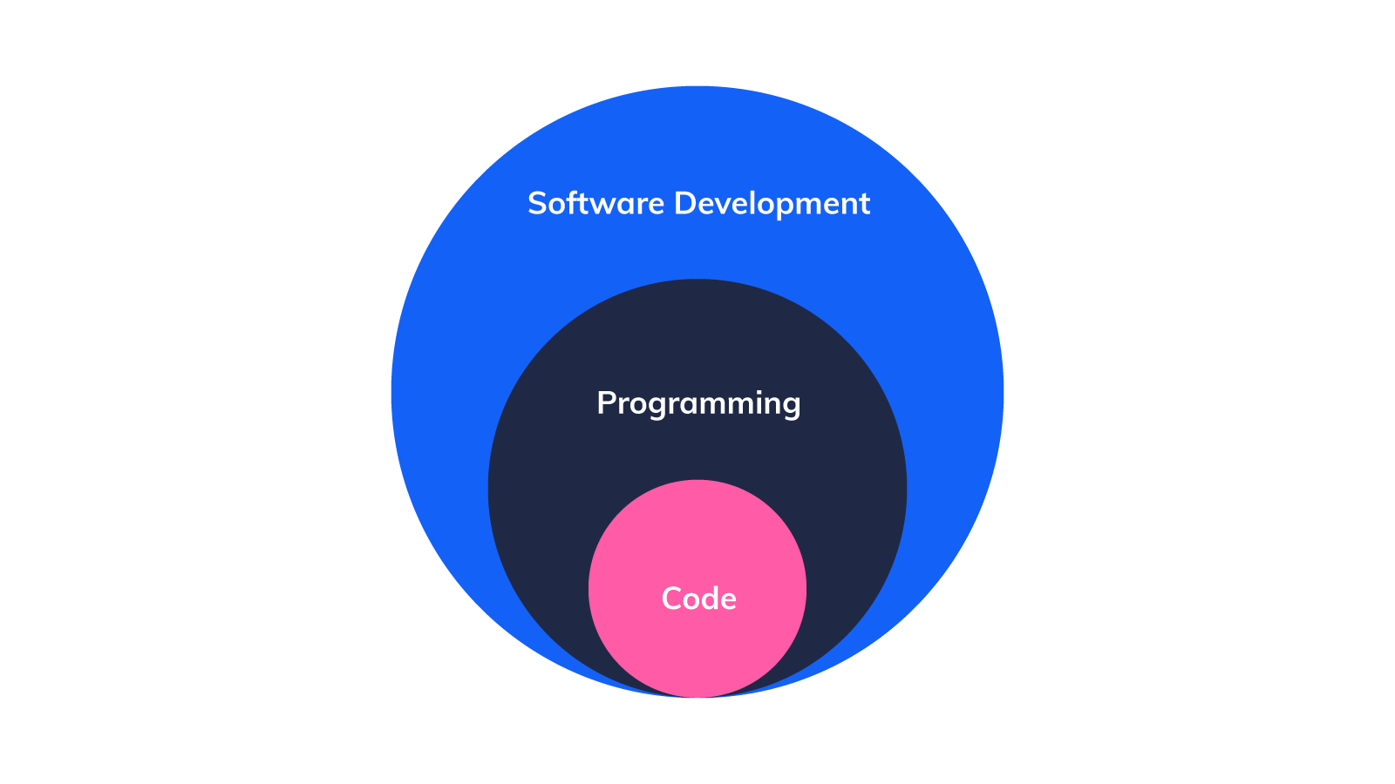
Code, Programming, and Software Development
Notes:
Software development = Ecosystem, usually for a complex program, aspects include requirement analysis, software versioning, code maintenance, deployment, teamwork, user testing, all management stuff
According to IBM Research: “Software development refers to a set of computer science activities dedicated to the process of creating, designing, deploying and supporting software.”
https://www.freecodecamp.org/news/what-is-computer-programming-defining-software-development/

Slide 16

Thanks
and have fun programming!
Notes:
https://www.iconfinder.com/icons/4375050/logo_python_icon

